Slide 1
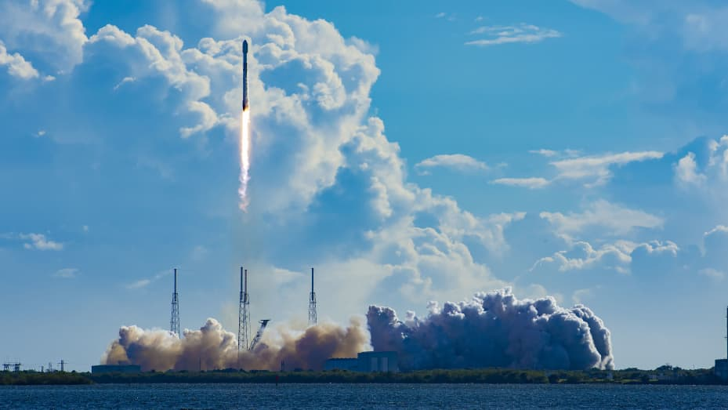
Analysis of reusable rockets
Noah McMahon
11-21-2023

Slide 2
Outline
Executive Summary
Introduction
Methodology
Results
Conclusion
Appendix

Slide 3
Executive Summary
Methodologies Used in this Analysis
Data Collection by web scraping and usage of Spacex API
Exploratory Data Analysis(EDA)
Includes data wrangling, visualization, and interactive visual analytics
Machine Learning Prediction
Summary of all results
Collecting public data was possible
EDA methods found which features are best for predicting landing success
Machine Learning provided the best model for predicting impactful characteristics on outcome

Slide 4
Introduction
Objective of Analysis
To evaluate the possibility for new company SpaceY to compete with SpaceX
Questions to Solve
Where is the best place to have launches?
What is the best way to predict successful launches and thus estimate the total cost of the launch?

Slide 5

Methodology

Slide 6

Data Collection
Sources used to obtain SpaceX data
SpaceX API - "https://api.spacexdata.com/v4/launches/past"
Webscraping – https://en.wikipedia.org/w/index.php?title=List_of_Falcon_9_and_Falcon_Heavy_launches&oldid=1027686922
SpaceX API
Used data wrangling and formatting methods to create usable data
Webscraping
Took data from online website (Wikipedia) and created a data frame to be used for analysis

Slide 7
Data Wrangling
Initial EDA was performed on the collected data
Several data points were found including:
The number of launches at each site
The number and occurrence of each orbit
The number and occurrence of mission outcomes of orbits
A landing outcome label was then created to organize the mission outcomes

Slide 8

EDA With SQL
SQL allowed for further analysis to find:
Commonalities between features in the data frame
Calculations such as Total Payload Mass for certain customers and booster versions
Which boosters had the most success with certain features
Spread of outcome type across time spans

Slide 9

EDA With Visualization
Used multiple types of charts and plots to see patterns in the data
Scatter plots included:
Flight Number vs. Payload Mass
Flight Number vs. Launch Site
Payload Mass vs. Launch Site
Bar Graph included:
Success rate by orbit type
Line Graph included:
Launch Success Rate as a yearly trend line

Slide 10

Visualization with Folium
Created a map with multiple features including:
All launch site locations
Successful launch outcomes and failures per launch site
Created clusters of these marks on the map
Calculated distances between launch sites and their proximities
Proximities included:
Highway
Coastline
Railway

Slide 11
Dashboard by Plotly Dash
Created two charts on an interactive dashboard
Pie chart displaying Percentage of launches by site
Scatter plot displaying the launches by payload in a specified range
The interactive dashboard allows for quick adjustments to be made to the data and filtering to be applied on the spot

Slide 12
Machine Learning
Used multiple Classification techniques including:
Logistic Regression
Support Vector Machine
Decision Tree Classifier
K Nearest Neighbors
Each model type was trained and tested with prepared and standardized data. The results were then compared

Slide 13

Results

Slide 14
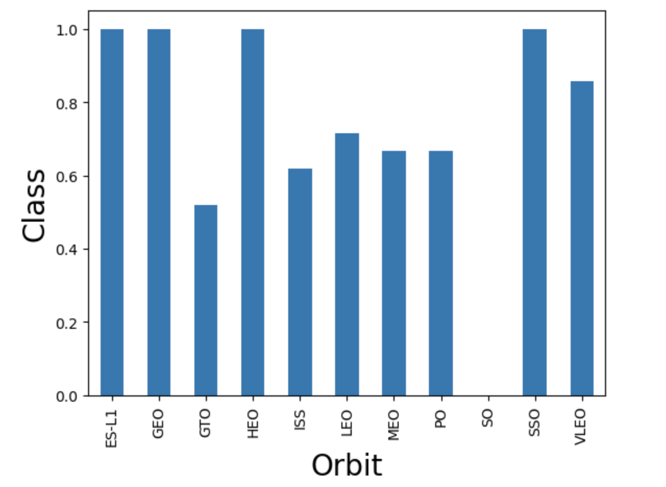
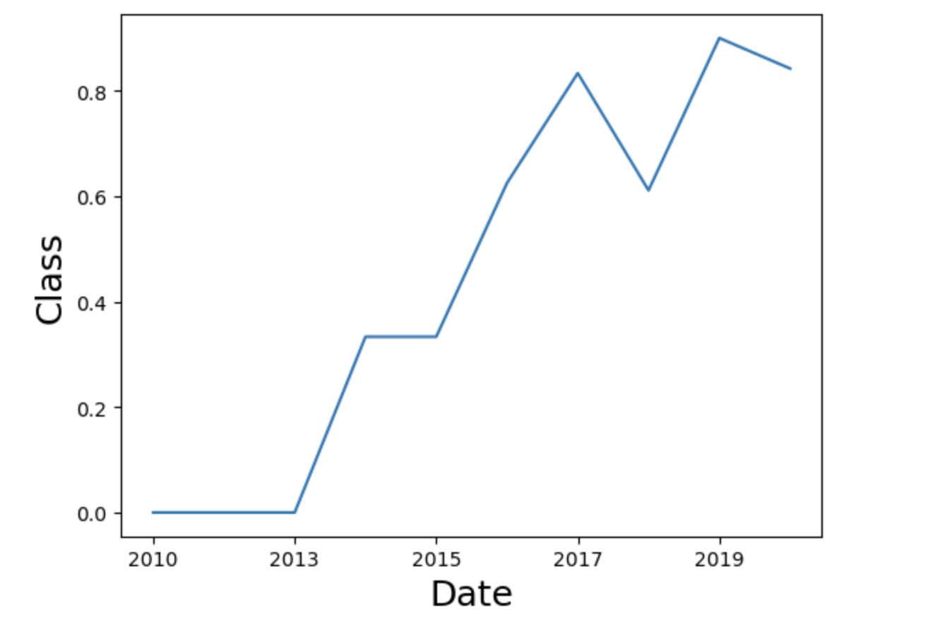
EDA Results
Initial Findings
4 launch sites
Average payload mass for F9 v1.1 booster is 2,928.4 kg
The first successful landing was in 2015
There has been 99 successful mission outcomes, 1 failure in flight and 1
Further Analysis found
Some orbits succeed far more than others
GTO orbits only succeed around half the time
Meanwhile ES-L1 and GEO orbits have never failed
The average success rate has increased as years have passed between 2013 and 2020

Slide 15
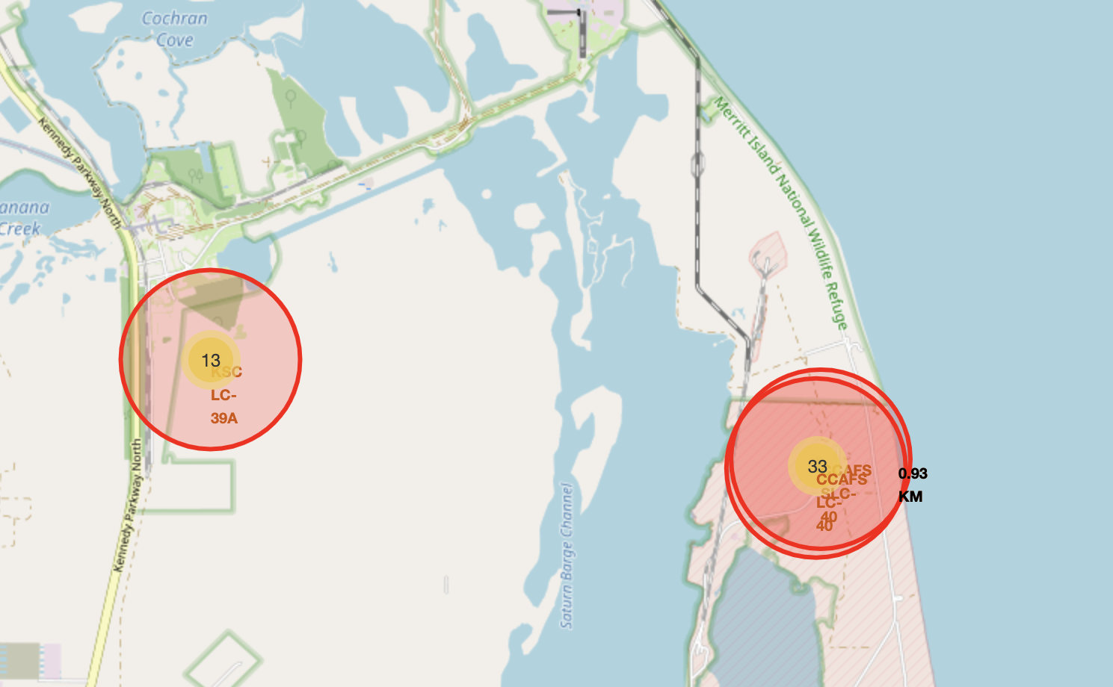
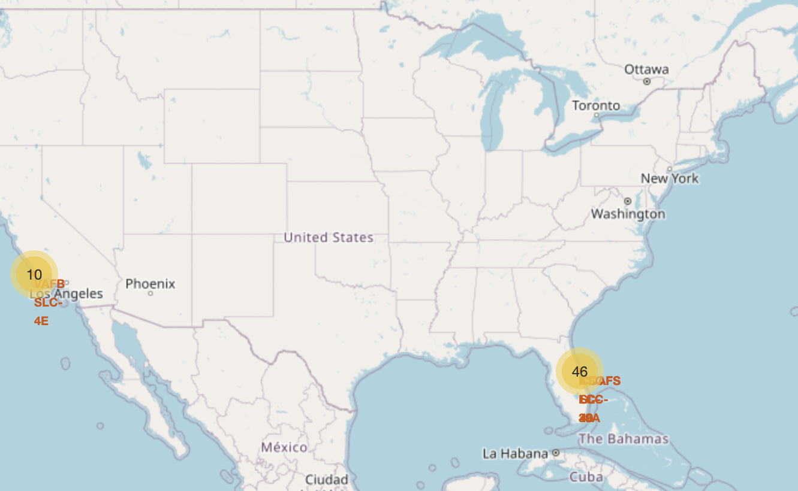
Folium Results
The generated maps provided numerous key insights
Most launches occurred on the east coast
Launch Sites are close to the coastline and are a considerable distance from nearby cities, i.e. safer locations
All sites have similar latitudes i.e. distances from equator

Slide 16
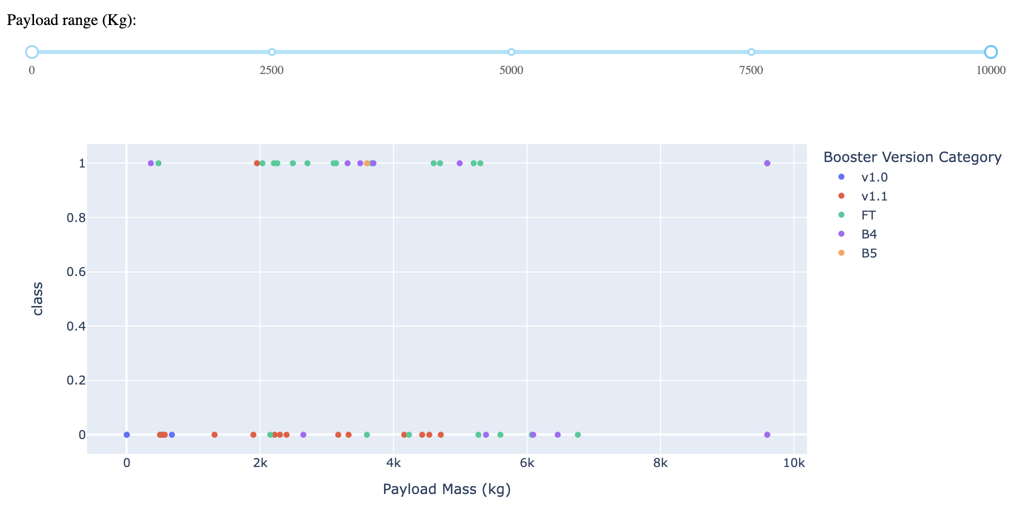
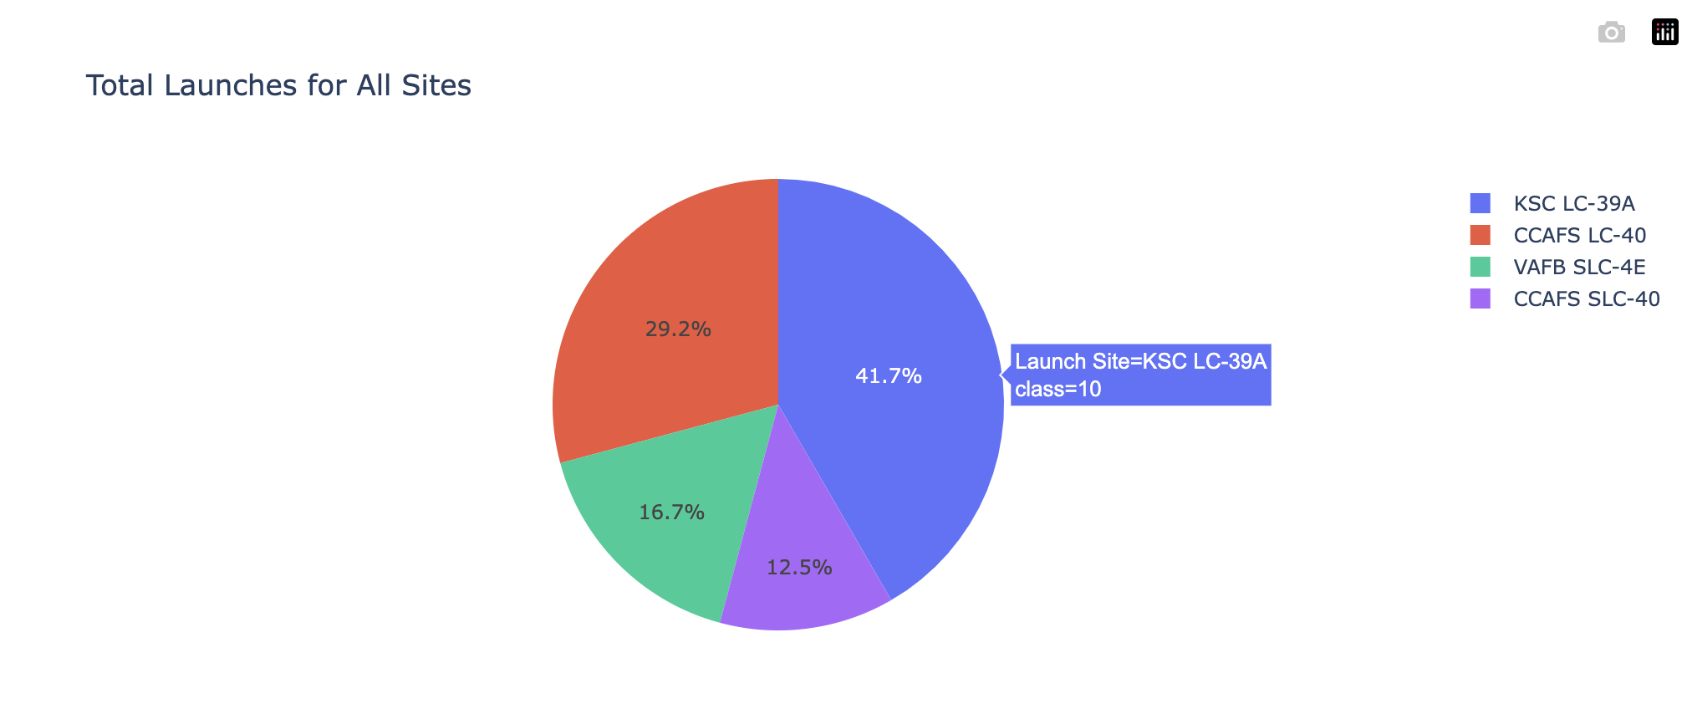
Plotly Dash Results
Most of the Payload Masses were in the 2,000kg to 6,000kg range
The v1.1 failed the most often
KSC LC-39A in Florida had the largest percentage of launches
Florida sites held the most launches at 83.3%

Slide 17
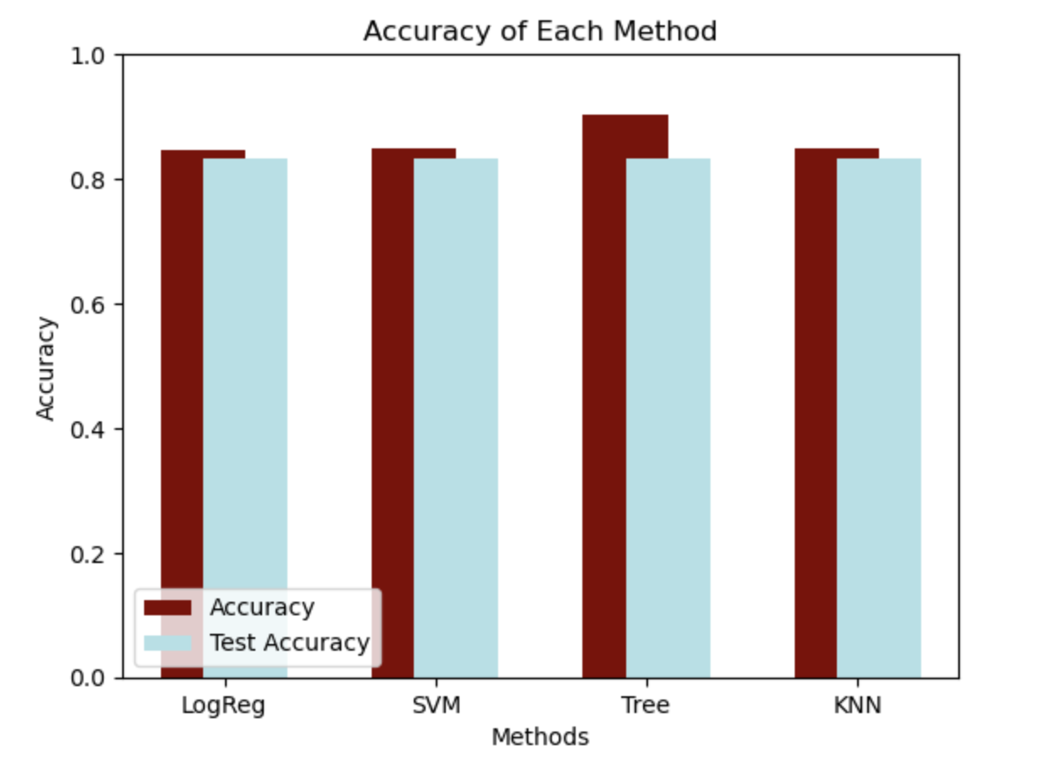
Machine Learning Results
The Decision Tree model was most accurate
Accuracy of 90.4% and Test Accuracy of 83.3%
The other models performed very similarly
The Logistic Regression model was slightly worse

Slide 18
Conclusion
Through this analysis, a few important factors have been understood for a successful mission
Having a mission with an orbit of ES-L1, GEO, HEO, or SSO have the greatest probability of success
Choosing a launch site on the east coast in a safe area
Example: In Florida, near the coastline, away from cities, area with access to industrial transport like railways or highways
Best site is KSC LC-39A
Keeping payload in the range of 2,000 kg to 6,000kg is safest
A Decision Tree Classifier is the best way to predict successful landings and improve company profits

Slide 19
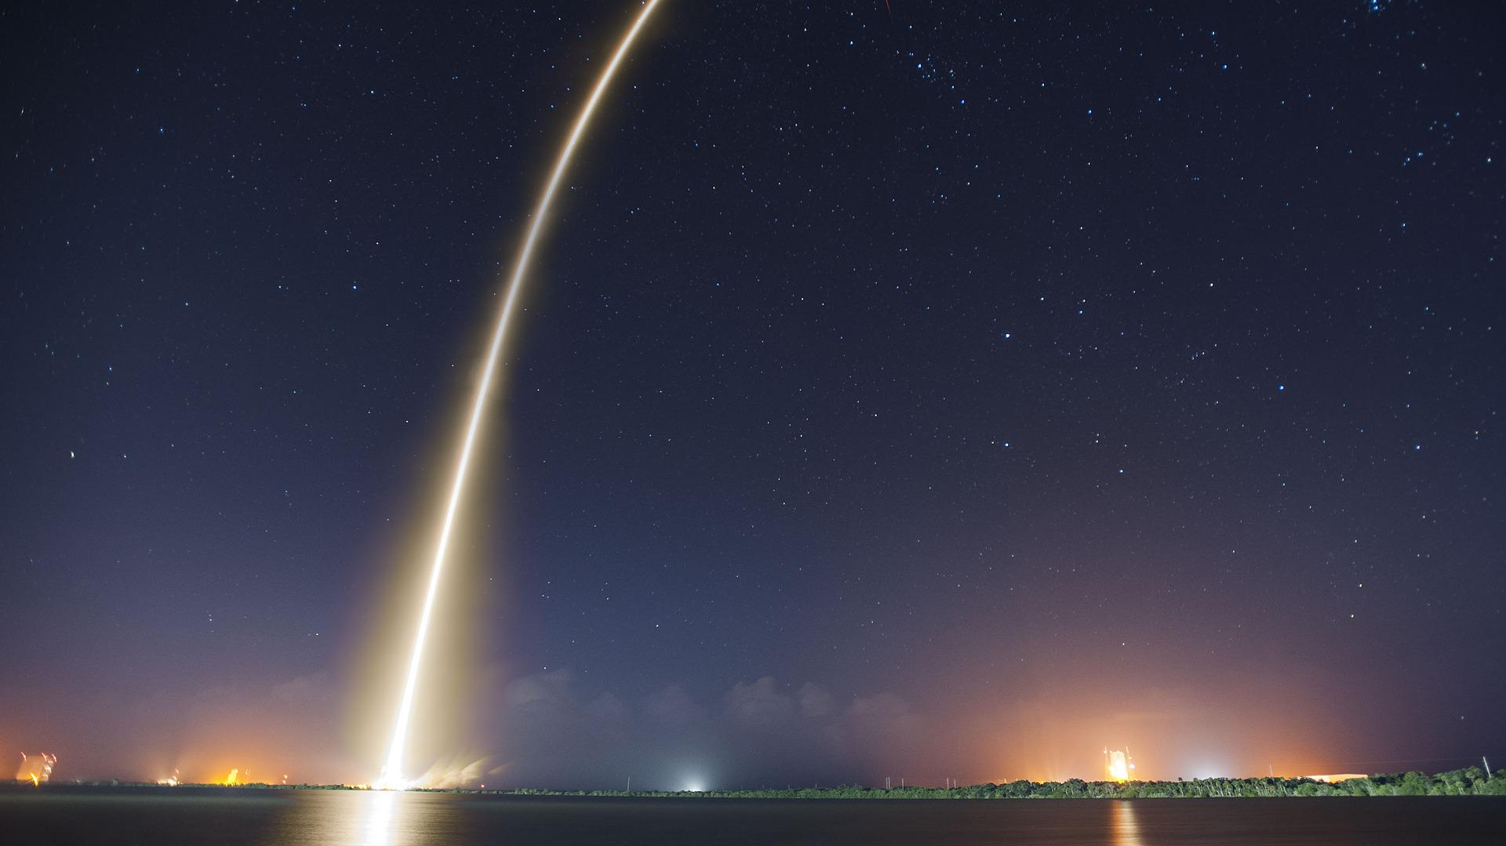
Thank you!

